Slide 1

Database Normalization

Slide 2
Normalization
Normalization is a process for assigning attributes to entities.
Normalization reduces data redundancies and helps eliminate the data anomalies that result from those redundancies.
Normalization works through a series of stages called Normal Forms. The first three stages are described as First Normal Form (1NF), Second Normal Form (2NF) and Third Normal Form (3NF).

Slide 3
Normalization
Although normalization is a very important database design ingredient, you should not assume that the highest level of normalization is always the most desirable
Generally, the higher the normal form, the more the joins are required to produce a specific output and the slower the database system responds to the end user demands.

Slide 4

Denormalization
Occasionally some portions of the database design my have to be Denormalized meaning 3NF would be converted to 2NF

Slide 5

What is First Normal Form (1NF)?
A relationship is said to be in 1NF if and only if every entry of the relation has at most a single value.

Slide 6

1NF
The term first normal form (1NF) describes the tabular format in which:
  All the key attributes are defined
  There is no repeating groups in the table
  All attributes are dependent on the primary key

Slide 7
Putting the Table into 1NF
The table needs to be decomposed into two new tables that will replace the original table.
First define the attibute(s) that can be used as unique identifiers

Slide 8

1NF cont.
The first table will contain the table identifier for the original table plus all the nonrepeating attributes.

Slide 9

INF cont.
The other table will contain a copy of the table identifier and all repeating attributes.

Slide 10

1NF cont.
If the repeating groups have other repeating groups within themselves, this process can be repeated as required.

Slide 11
The Original Project Table
Pro_ID | Pname | Pro_mgr_id | Emp_id | Emp_name | Emp_dept | Emp_rate
100 | E-comm | 1235 | 1234 1254 | Smith Jane | MIS Acct | 65 85
110 | Dist-Ed | 1254 | 1548 1235 | Margo Don | HR Acct | 45 38
120 | Cyberspace | 1478 | 1598 1235 | James Don | MIS Acct | 25 38
130 | webpage | 1598 | 1234 1548 | Smith Margo | MIS HR | 65 45

Slide 12
The First Table
Pro_ID | Pname | Pro_mgr_id
100 | E-comm | 1235
110 | Dist-Ed | 1254
120 | Cyberspace | 1478
130 | webpage | 1598

Slide 13
The Second Table:
Pro_ID | Emp_id | Emp_name | Emp_dept | Emp_rate
100 | 1234 | Smith | MIS | 65
100 | 1254 | Jane | Acct | 85
110 | 1548 | Margo | HR | 45
110 | 1235 | Don | Acct | 38
120 | 1598 | James | MIS | 25
120 | 1235 | Don | Acct | 38
130 | 1234 | Smith | MIS | 65
130 | 1548 | Margo | HR | 45

Slide 14
Data Anomalies
Side effects that the data experience as a result of some relational operations.
Three Categories:
  Inserts
  Updates
  Deletes

Slide 15
Insertion Anomalies
In our Table 2, we cannot insert data about a new employee that is going to work for a particular department unless that employee is already assigned to a project.
Pro_ID | Emp_id | Emp_name | Emp_dept | Emp_rate

Slide 16
Deletion Anomalies:
If we delete the project information that connects an employee to a particular project, we lose information about the department for which this employee works.

Slide 17
Update Anomalies
The department for which an employee works may appear many times in the table. So if an employee transfers departments, we need to update several instances of the department. If we miss one, or forget to update all occurences, then we our database will contain inconsistent information.

Slide 18
Second Normal Form (2NF)
Relations are in 2NF if they are in 1NF and all non-key attributes are dependent on the entire primary key
To be dependent on the entire key, a field must not be able to be identified by any single part of the key (Partial dependency)
All relations with a single attribute key are, by default, in second normal form (2NF)

Slide 19
Converting From 1NF to 2NF
For each attribute composing the primary key that is a determinant, create a separate relation
Create additional, separate relations for all combinations of the primary key fields taken two at a time, three at at time and so on until the whole primary key is used.
Designate the portions of the primary key as the primary key for those relations
Next place the rest of the fields with the primary key on which they depend
When finished, remove any relations that have additional fields added.

Slide 20
2NF Example
PROJECTS(PROJ_NO, PROJ_NAME, EMP_NO, EMP_NAME, JOB_CLASS, CHG_HRS, HRS_BILLED)
  PROJ_NO determines →PROJ_NAME
  EMP_NO determines→EMP_NAME, JOB_CLASS, CHG_HOURS
  PROJ_NO & EMP_NO determines→HOURS-BILLED

Slide 21
PROJECT(PROJ_NO, PROJ_NAME)
EMPLOYEE(EMP_NO, EMP_NAME, JOB_CLASS, CHG_HOURS)
ASSIGN(PROJ_NO, EMP_NO, HOURS_BILLED)

Slide 22
2NF Example 2
ORDERS(ORDNUM, ORDDATE, PRODNUM, PRODDESC, NUMORDERED)
  ORDNUM determines →ORDDATE
  PRODNUM→ PRODDESC
  ORDNUM & PRODNUM→ NUMORDERED

Slide 23
ORDERS(ORDNUM, ORDDATE)
PRODUCTS(PRODUCT_NUM, PROD_DESC)
ORDEREDPRODUCT(ORD_NUM, PROD_NUM, NUM_ORDERED)

Slide 24
2NF
A Table is in 2NF
  It is in 1NF
  It includes no partial dependencies; that is, no attribute is dependent on only a portion of the primary key
  (It is still possible for a table in 2NF to exhibit transitive dependency, that is one or more attributes my be functionally dependent on non-key attributes

Slide 25
Third Normal Form 3NF
A relation is in 3NF, if it is in 2NF and all non-key attributes depend only on the key.
Consider the following relation in 2NF:
  CUSTOMER(CUSTNUM, NAME, ADDR, SALESREPNUM, SALESREPNAME)
  Because the relation has a single field key, it must be in 2NF
  However other functional dependencies exist
    SALESREPNUM→SALESREPNAME

Slide 26
2NF →3NF
To convert these relations to 3NF, remove all attributes which are dependent on non-key attributes
For each separate dependency create a relation with the determinant as the primary key
Keep the determinate in the original relation as a foreign key

Slide 27
2NF→3NF
Keep in relation 1
Copy to relation 2
CUSTNUM→SALESREPNUM→ SALESREPNAME
This is know as a Transitive Dependency-SALESNAME is dependent on SALESREPNUM, but neither attribute is at least part of the key. To remove this transitive dependency, create the following:
  CUSTOMER(CUSTNUM,NAME,ADDR,SALESREPNUM)
  SALE-REP(SALESREPNUM, SALESREPNAME)
Kept as a Foreign Key

Slide 28
3NF Example
PROJECT(PROJ_NO, PROJ_NAME)
EMPLOYEE(EMP_NO, EMP_NAME, JOB_CLASS)
ASSIGN(PROJ_NO, EMP_NO, HOURS_BILLED)
JOB(JOB_CLASS, CHG_HOURS)

Slide 29
3NF
A table is 3NF if:
  It is in 2NF
  It contains no transitive dependencies

Slide 30
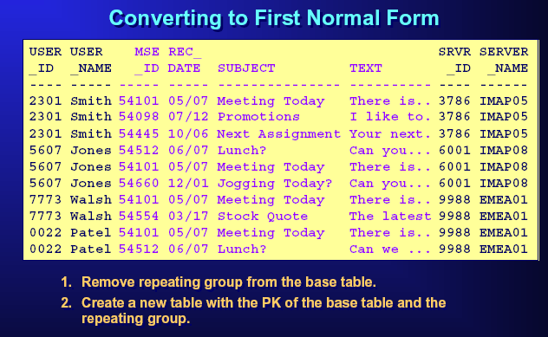

Slide 31
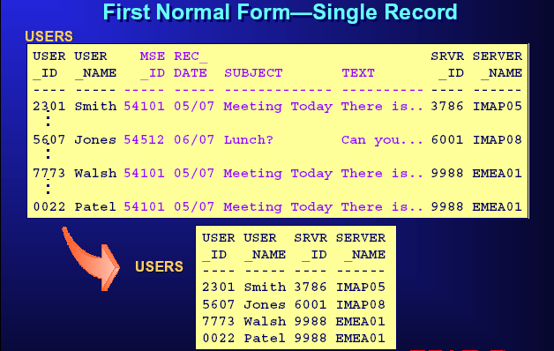

Slide 32
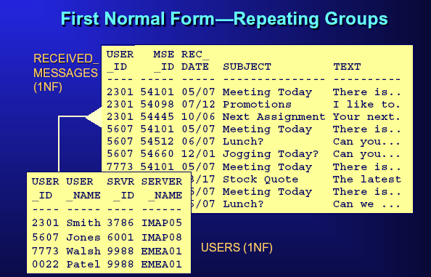

Slide 33
Converting to 2nd Normal Form
Determine which non-key columns that are not dependent on the table’s entire primary key
Remove those columns from the base table
Create a second table with those columns and the column from the PK that they are dependent on

Slide 34
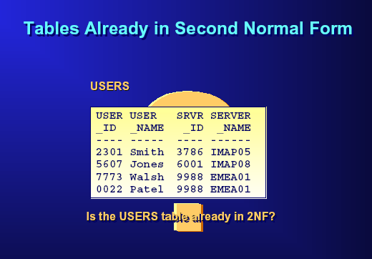

Slide 35
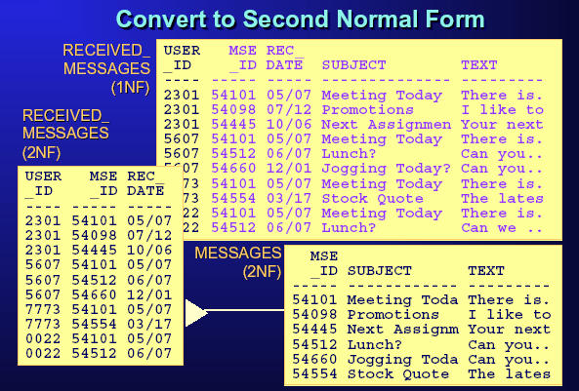

Slide 36
Converting to 3NF
Remove any columns that are dependent on another non-key column
  Determine which columns are dependent on another non-key column
  Remove these columns from the base table
  Create a second table with those columns and the non-key columns that they are dependent on

Slide 37
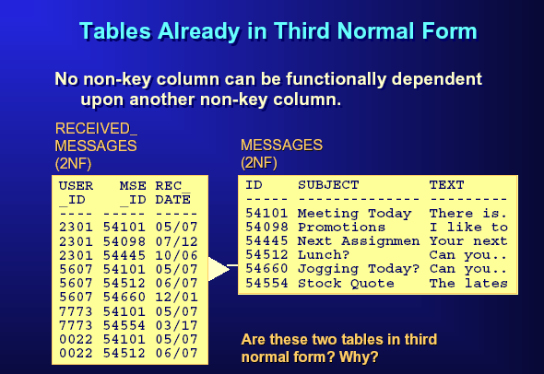

Slide 38
